Slide 1


Xpey’ Relational Environments
A Tree Model for Understanding Indigenous Health Equity
Alexandra Kent- Equity Lens in Public Health
Haida Tree by kireihiryu
http://kireihiryu.deviantart.com/art/Haida-Tree-173902964

Slide 2


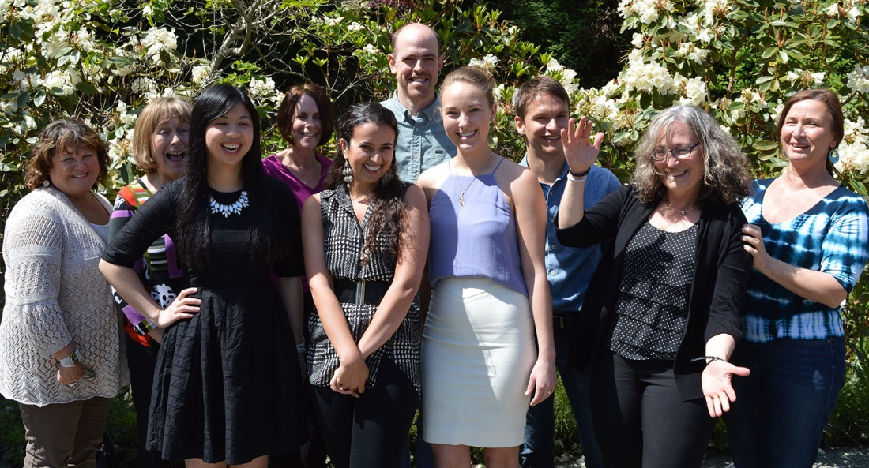



Acknowledgements
University
of Victoria
Centre for Aboriginal Health Research

Slide 3
ELPH Research Program
Health equity priorities and strategies
Health equity priorities and strategies
Integrated knowledge
translation and exchange
Intersectoral collaboration
Power and ethics in public health
Health equity tools

Slide 4
Study 1: Health Equity Priorities & Strategies
Purpose:
  Identify HA activity on health equity and inequity reduction
  Determine whether and how health equity is prioritized
  Explore the contextual influences on priorities and health equity plans/ strategies
  Understand how and what explains changes over the course of the study
  Emphasis on mental health and substance use
Case Studies:
  Regional health authorities
  Province-wide analysis
Methodology:
  Baseline and follow-up analyses
  Situational analysis and ordered maps
  Social worlds/ arenas maps
  Positional maps
Documents:
  Service Plans
  Strategic Plans
  Aboriginal Health Plans
Interviews and Focus Groups:
  Frontline staff
  Managers
  Directors
  Senior executives

Slide 5
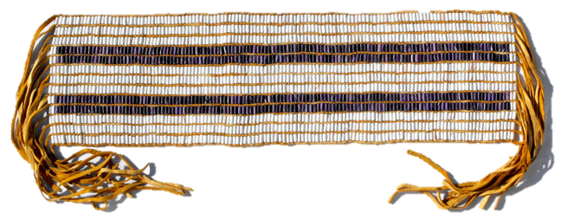
Parallel Analyses
Study 1: Health Equity Priorities and Strategies
Situational Analysis
Indigenous Analysis

Slide 6
Indigenous Analysis
Purpose:
  Conceptualize relational environments within the public health system using tree model
  Identify barriers and facilitators to health equity for Indigenous peoples in BC
  Analyze the uptake and implementation of Indigenous health equity as a priority in BC health authorities
Significance
  Pronounced inequity among BC’s Indigenous populations
  Culturally-relevant framework of analysis

Slide 7


What is Health Equity?
Equity:
“The absence of avoidable or remediable differences among groups of people, whether those groups are defined socially, economically, demographically, or geographically.”
-World Health Organization, 2014
Inequity:
“Differences in health which are not only unnecessary and avoidable, but, in addition, are considered unfair and unjust.”
-Margaret Whitehead, 1992, The Concepts and Principles of Equity in Health

Slide 8
Indigenous Framework
of Relational Environments
Stem Environments
Core Environments
Root Environments

Slide 9

Stem Environments
Non- Human
Human
Symbolic

Slide 10



Core Environments
Systems
Institutions
Communities

Slide 11


Root Environments
Social
Political
Historical
Cultural

Slide 12
Preliminary Findings
  Conceptualize relational environments within the public health system using tree model

Slide 13
Preliminary Findings
Relational Environments in the Data

Slide 14
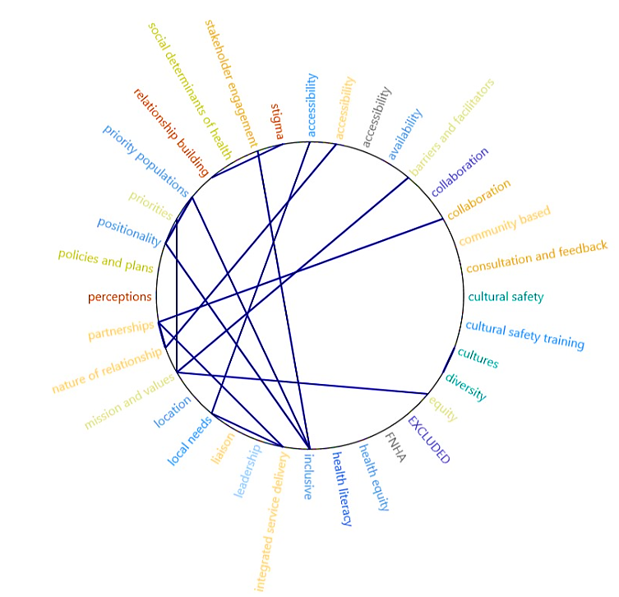
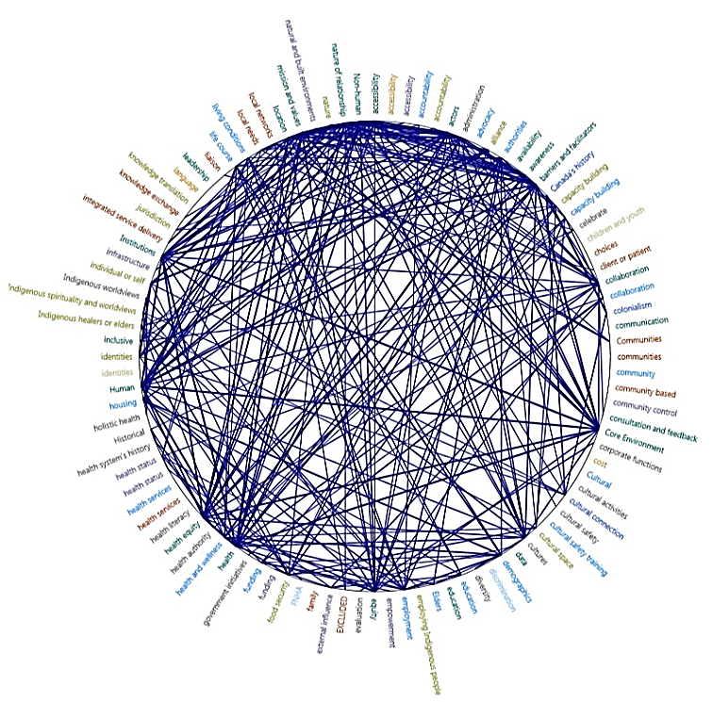

Slide 15
Preliminary Findings
  Conceptualize relational environments within the public health system using tree model
  Identify barriers and facilitators to health equity for Indigenous peoples in BC

Slide 16
Barriers & Facilitators to Health Equity
Frequent
Less frequent
Collaboration
Integrated Service
Delivery
Accessibility
Location
Community
Based
Relationship Building
Stigma
Cultural
Safety
Partnerships
Trust

Slide 17
Preliminary Findings
  Conceptualize relational environments within the public health system using tree model
  Identify barriers and facilitators to health equity for Indigenous peoples in BC
  Analyze the uptake and implementation of Indigenous health equity as a priority in BC health authorities

Slide 18
Preliminary Findings
Equity References in Data Sources

Slide 19
Preliminary Findings
Indigenous References in Data Sources

Slide 20

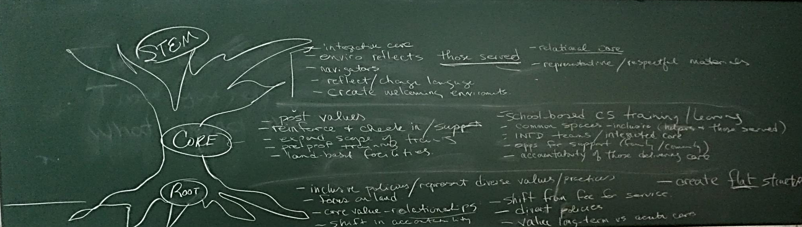
What’s Next…
Phase 2 (follow-up)
Higher level analysis
Stakeholder engagement
Dissemination (case reports and publications)
Project Expansion

Slide 21
Questions?
Contact Information
Alexandra Kent
Email: alexandrakent@hotmail.com
Phone: (604)316-2286

Slide 22
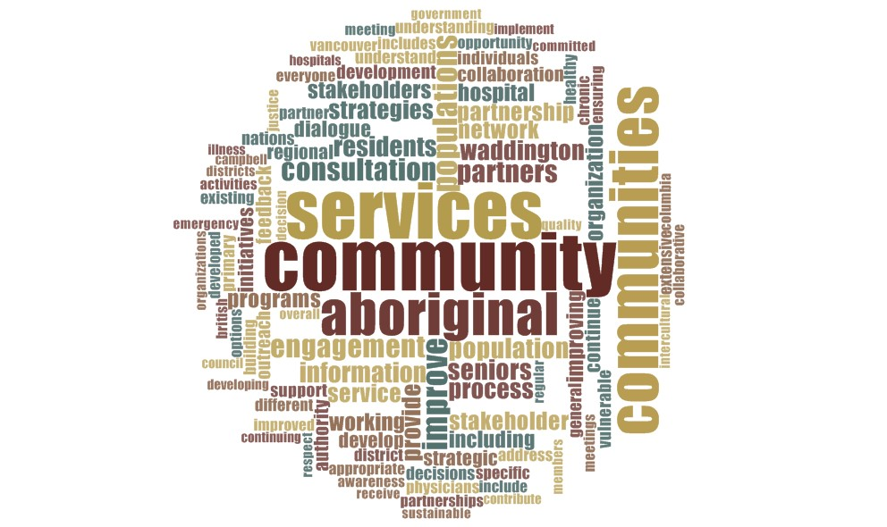
Stem Themes

Slide 23
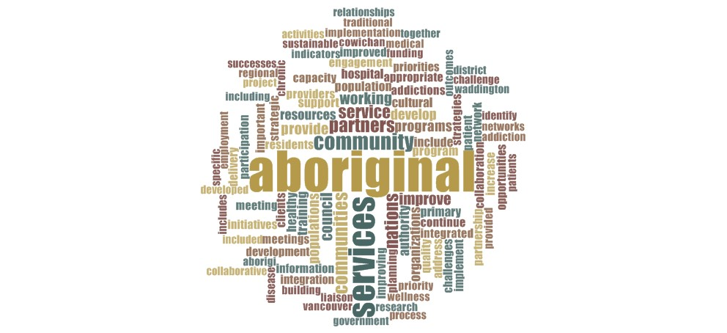
Core Themes

Slide 24
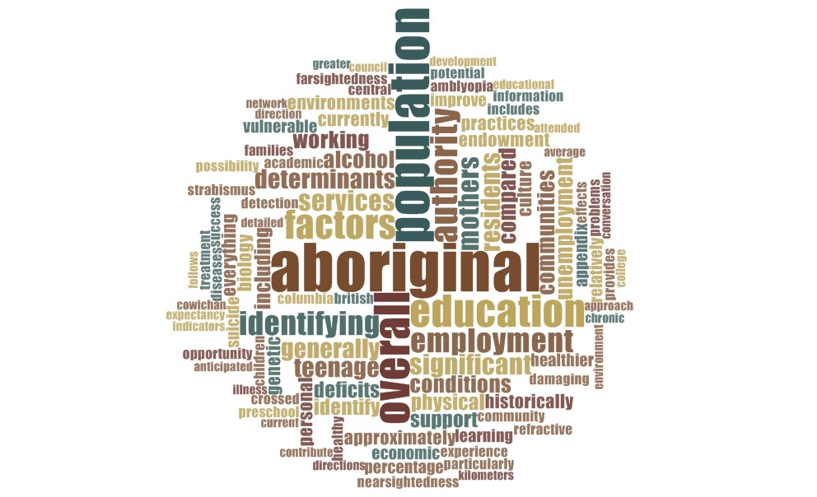
Root Themes

